Slide 1
Smart Borewell Safety System Subtitle: Preventing Accidents at Uncovered Borewells and Open Pits
Presented by: [Your Name] Date: [Presentation Date]

Slide 2
Abstract
Overview of the Smart Borewell Safety System aimed at addressing accidents involving children and animals falling into open borewells.
The system is designed to detect movement around borewells using proximity sensors.
Wireless communication technology transmits alerts to a centralized unit.
Solar power ensures continuous operation, even in remote areas.
The system enables real-time monitoring and rapid response to prevent accidents.

Slide 3
Literature Review
Research highlights numerous incidents of children and animals trapped in uncovered borewells.
Existing solutions are often reactive, involving manual covers or barricades, which may be insufficient.
Modern safety systems incorporating IoT and sensor-based monitoring have shown promise but lack widespread implementation.
Identified the need for a comprehensive system combining detection, alerting, and remote monitoring.

Slide 4
Problem Statement
Uncovered borewells pose a significant safety hazard, particularly in rural and agricultural areas.
Children and animals frequently fall into open borewells, resulting in injuries or fatalities.
Lack of real-time detection systems leads to delayed rescue operations, reducing the chances of survival.
Current preventive measures are often ignored or poorly maintained.

Slide 5
Child Rescue System from Open Borewells

Slide 6
Proposed Solution
Integration of Proximity Sensors: Detects movement near open borewells.
Wireless Communication Module: Transmits signals to a remote monitoring unit.
Centralized Master Receiving Unit: Collects data and triggers alarms.
Solar Power: Ensures continuous operation in off-grid and remote areas.

Slide 7
Architectural Design for Proposed System
Sensor Unit with Solar Power: Detects movement and powers the system independently.
Wireless Communication Network: Facilitates real-time data transmission.
Master Receiving Unit: Processes data and triggers alarms.
Remote Monitoring Dashboard: Provides visual alerts and status updates.

Slide 8
Block Diagram -- Field Device
PIR SENSOR
ARDUINO UNO
RF Module
ULTRASONIC SENSOR
Buzzer
Solar Panel & Power supply unit

Slide 9
Block Diagram – Hub Device
LCD
RF Module
Arduino uno
WARNING INDICATOR
Buzzer
Power supply unit

Slide 10
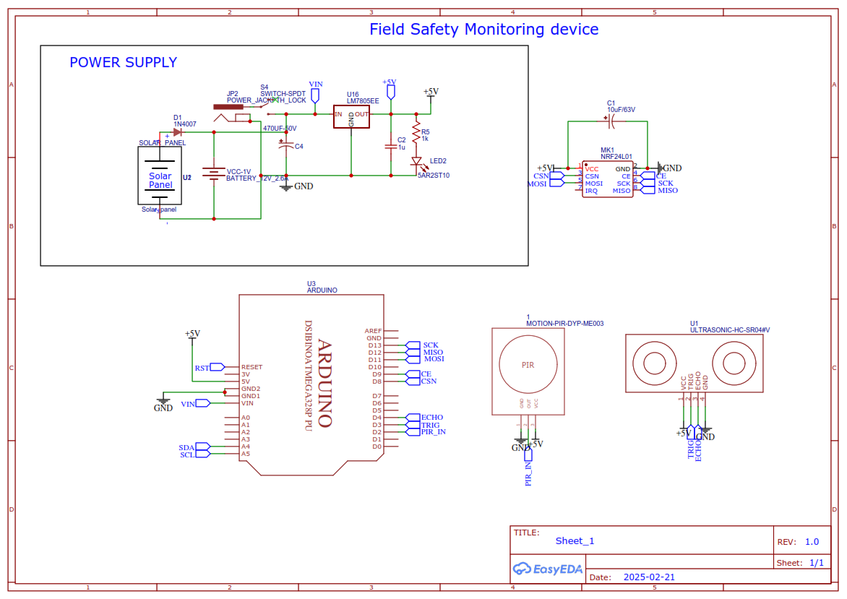

Slide 11
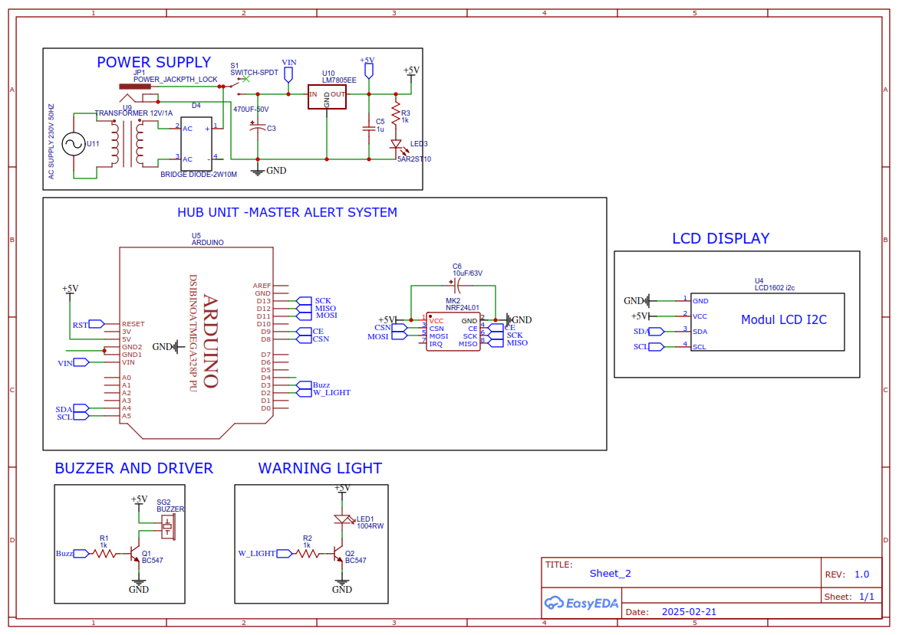

Slide 12
Working Mechanism
Step 1: Proximity Sensor detects any movement near the borewell.
Step 2: Local Alarm activates, warning individuals nearby.
Step 3: Wireless Signal is transmitted to the master receiving unit.
Step 4: Remote Alert is triggered at the monitoring station, enabling swift intervention.

Slide 13
Algorithms / Techniques Used
Movement Detection Algorithm: Analyzes sensor data to identify nearby activity.
Wireless Signal Processing: Ensures fast and reliable data transmission.
Alarm Activation Logic: Triggers alarms based on threshold movement detection.

Slide 14
Expected Outcomes
Significant reduction in borewell-related accidents.
Real-time alerts ensure quick responses, minimizing injury risks.
Solar-powered system offers long-term reliability and low maintenance.
Improved safety awareness and protection in vulnerable areas.

Slide 15
Software Requirements
Arduino IDE
– Embedded C programming
Easy Eda
– Schematic design

Slide 16
Key Advantages
Safety Enhancement: Prevents falls into borewells.
Solar-Powered Sustainability: Operates in off-grid areas.
Scalability: Supports deployment across multiple borewells.
Real-time Monitoring: Enables quick intervention.

Slide 17
Applications
Rural High-Risk Areas: Where open borewells are common.
Construction Sites: To secure open pits.
Agricultural Fields: To prevent accidental falls into uncovered borewells.

Slide 18
Future Enhancements
AI-Based Object Detection: Identifying children, animals, or other objects specifically.
Integration with Emergency Services: Automated alerts to rescue teams.
Improved Sensor Precision: Enhancing movement detection accuracy.

Slide 19
References
Research Papers on Borewell Safety Systems
Innovative Child Rescue System from Borewell using Arduino -DOI: 10.1109/ICIDCA56705.2023.10099490
Smart Borewell Child Rescue System -DOI : 10.17577/IJERTCONV12IS02049
Pipeline inspection and borewell rescue robot "Palwinder kaur, Ravinder kaur, Gurpreet singh

Slide 20
Conclusion
The Smart Borewell Safety System is a proactive, sustainable solution to prevent borewell accidents.
Combining sensor technology, wireless communication, and solar power, it ensures safety and rapid response.

Slide 21
Q&A
Thank You!
Questions?

